Slide 1
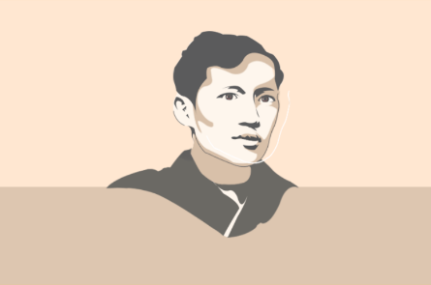
RIZAL’S LIFE, WORKS AND WRITING
By: Ms. Florilyn B. Villaflores
Lecturer

Slide 2
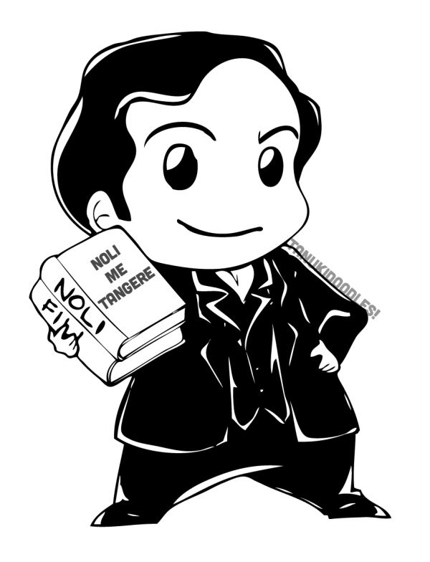
What is the study of ancestry and family histories?

Slide 3
GENEALOGY OF JOSE RIZAL

Slide 4
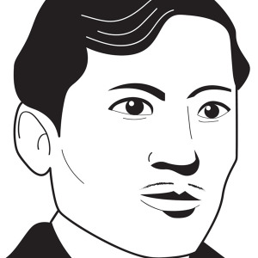
GENEALOGY OF JOSE RIZAL
He was born on June 19, 1861 in Calamba, Laguna.
His mother almost die.

Slide 5
Who baptized Rizal?

Slide 6
On June 27, 1861, Rizal was baptized by
Fr. Rufino Collantes.
While Fr. Pedro Casañas stood as Rizal’s godfather.

Slide 7
What did Fr. Rufino Collantes told his mother relating to his big head?

Slide 8
Jose – Patron Saint of workers.
Protacio – Saint and bishop of Milan.

Slide 9
Who are the parents of Rizal?

Slide 10
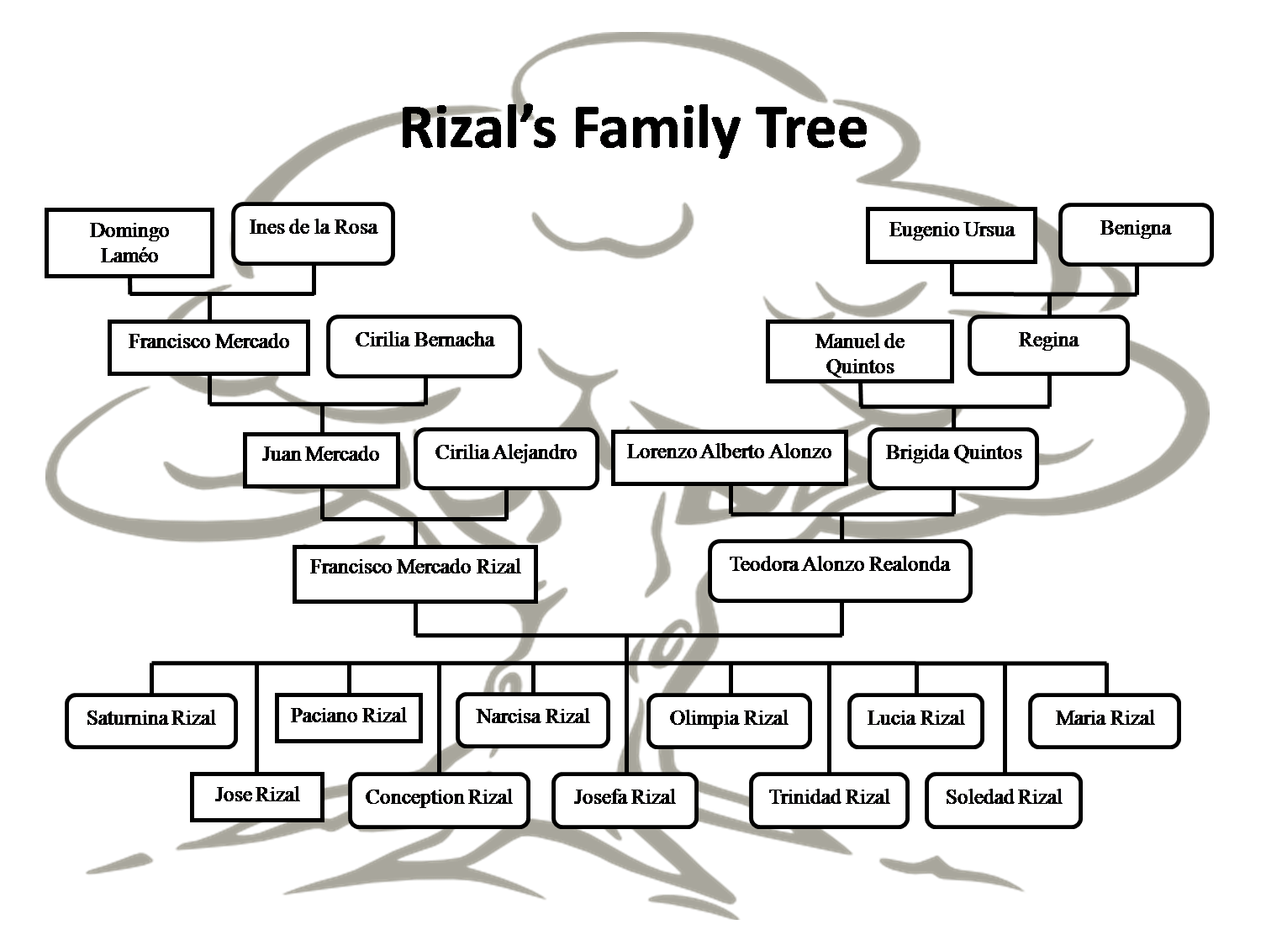

Slide 11
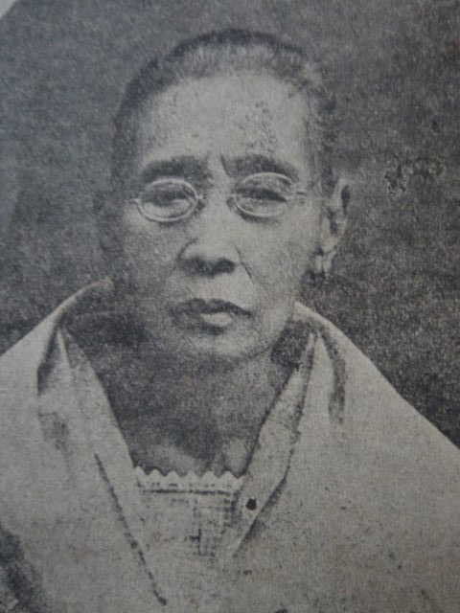
Teodora Alonzo
She was born on November 8, 1826 in Manila , and died on August 16, 1911 at the age of 85.
She studied at Colegio de Santa Rosa.

Slide 12
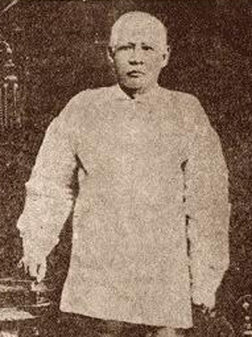
Francisco Mercado
He was born on May 11, 1818 in Biñan, Laguna, and died on January 5, 1898 at the age of 80.
He studied at Colegio de San Jose, Manila.

Slide 13
RIZAL CHILDREN
S
P
N
O
L
M
Saturnina
Paciano
Narcisa
Olympia
Lucia
Maria

Slide 14
RIZAL CHILDREN
Jose
J
C
J
T
S
Concepcion
Josefa
Trinidad
Soledad

Slide 15
Who brought Spanish surnames in Philipines?

Slide 16
A new family name was adopted in 1850 by authority of Royal Decree of 1849, upon the order of Governor Narciso Claveria.

Slide 17
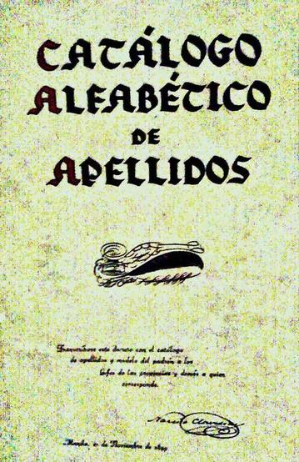
Catalogo Alfabetico
The publication included the list produced and approved family names.

Slide 18
Which was the status symbol of illustrados in Spanish Philippines?

Slide 19
Rizal Family belonged to a
middle – class family.
Rented Farms – Farming and Stockraising
Operating a small – flour mill/ home – made ham press.
Large stone house
Private Libraries
Sent children to colleges in Manila
They owned a carriage

Slide 20
What is the complete name of Rizal?

Slide 21
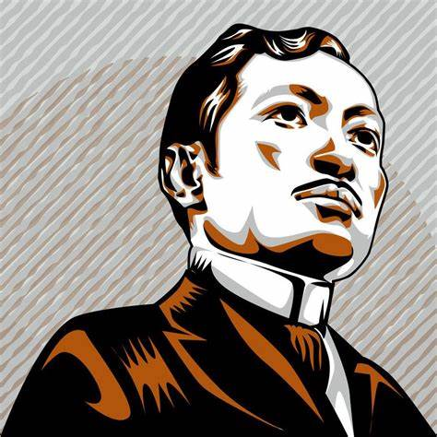
JOSE PROTACIO MERCADO RIZAL ALONZO Y REALONDA

Slide 22
RIZAL’S EARLY CHILDHOOD

Slide 23
What is the poem created by Rizal dedicated to his town (Calamba)?

Slide 24
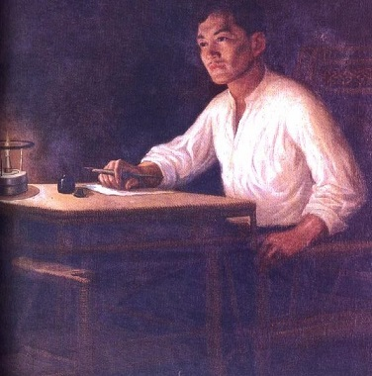
“Un Ricuerdo A Mi Pueblo”
(In Memory of my Town)

Slide 25
Early Childhood Memories
Happy Days in Family Garden
His aya’s tales
Daily Angelus Prayer

Slide 26
What is the reason of Rizal’s first sorrow?

Slide 27
“ When I was 4 years old, I lost my little sister Concha (Concepcion) and for the first time, I shed tears caused by love grief ”

Slide 28
Devoted Son of the Church
He takes part in Catholic prayers, activities.
Fr. Leoncio Lopez (admired by Rizal)

Slide 29
Pilgrimage to Antipolo
First lake Voyage

Slide 30
Narrate the Story of the Moth.

Slide 31
Story of the Moth
“Like that of the brave moth, he was fated to die as a martyr for a noble ideal”

Slide 32
Artistic Talent
At the age of 5, he began to make sketched with his pencil and to mould in clay and wax objects.

Slide 33
“ Laugh at me now, someday when I die people will make monuments and images of me ”

Slide 34
What is the title of the first poem written by Rizal?

Slide 35
“TO MY FELLOW CHILDREN”
(Sa Aking mga Kababata)

Slide 36
“TO MY FELLOW CHILDREN”
The Earliest Nationalist Sentiment of Rizal.
Tagalog is equal of Latin, English, Spanish.

Slide 37
Rizal as a boy Magician
Magic tricks
Puppets

Slide 38
Rizal’s first Drama
Tagalog Comedy performed during town festivals.
Gobernadorcillo purchased his tagalog comedy.

Slide 39
Lakeshore Reveries
The sad condition of his oppressed people awakened his nationalism.

Slide 40
Influences on Hero’s Boyhood
Hereditary Influence
Environmental Influence
Aid of Divine Providence

Slide 41
Hereditary Influence
MALAYAN ANCESTORS: Freedom, travel and courage
CHINESE ANCESTORS: Frugality, Patience, Love of Children
SPANISH ANCESTORS: Elegance, Gallantry

Slide 42
Environmental Influence
FAMILY: Religious Atmosphere
BROTHER (PACIANO): Love of Freedom
SISTERS: Courtesy to women
AYA: Interest to folklore
TIO ALBERTO: Artistic Ability
TIO MANUEL: Athletic Man
TIO GREGORIO: Love of Reading

Slide 43
Aid of Divine Providence
God – given gifts/ versatile gifts

Slide 44
EARLY EDUCATION IN CALAMBA AND BIÑAN

Slide 45
Who is Rizal’s first teacher?

Slide 46
Teodora Alonzo
His mother is his first teacher.
She discovered Rizal’s talent in Poetry.

Slide 47
Maestro Celestino
Rizal’s first tutor.
Maestro Lucas Padua
Rizal’s second tutor.

Slide 48
Leon Monroy
His father former classmate.
Latin and Spanish
5 months later, he died.

Slide 49
JOSE GOES TO BIÑAN
June 1869 , Jose left Calamba for Biñan.
They arrived almost night and he goes sightseeing with his cousin, Leandro.

Slide 50
Who is Rizal’s first teacher in Biñan?

Slide 51
FIRST DAY IN BIÑAN
The next morning, his brother sent him to the school of Maestro Justiniano Aquino Cruz.
He was laughed by Pedro, the teacher’s son.

Slide 52
Who was challenged by Jose to a fight?

Slide 53
FIRST SCHOOL BRAWL
Jose challenged Pedro to a fight.

Slide 54
Who challenged Jose to an arm-wrestling match?

Slide 55
A classmate named Andres Salandanan, challenge Jose to an arm-wrestling match.

Slide 56
Who taught Rizal painting and drawing in Biñan?

Slide 57
Old Juancho freely gave him lessons in drawing and painting.
He was with his classmate, Jose Guevarra.

Slide 58
DAILY LIFE IN BIÑAN
In his memoirs:
Attend 4 o’clock mass
Pick Mabolo
Finish class at 10 am and 5 pm.
In the moonlight, I play with my niece in the street.

Slide 59
BEST STUDENT IN SCHOOL
Jose beat all Biñan Boys.
Old classmates get jealous of him.

Slide 60
END OF BIÑAN SCHOOLING
After 1 and a half years of schooling, December 17, 1870.
Steamer Talim take him from Biñan to Calamba assisted by Arturo Camps.

Slide 61
What is the reason of the execution of Gomburza?

Slide 62
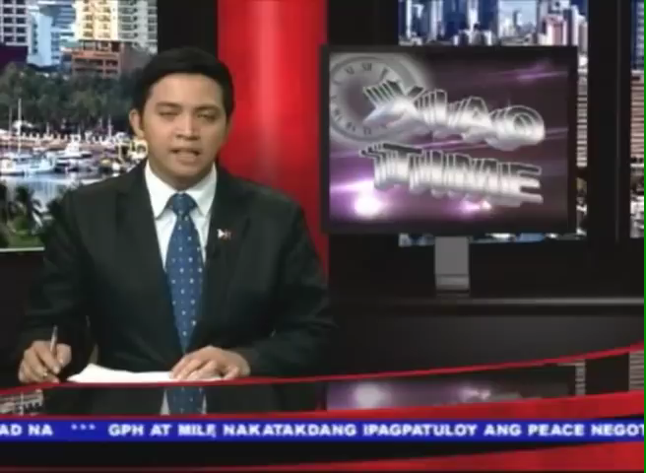

Slide 63
What: CAVITE MUTINY (an uprising)
Where: CAVITE
When: JANUARY 22, 1872
Who: LABORERS, SOLDIERS HEADED BY SGT. FRANCISCO LAMADRID.
WHY: ABOLITION OF THEIR PRIVELEGES (exemption from tribute and forced labor)

Slide 64
Who ordered the execution of Gomburza?

Slide 65
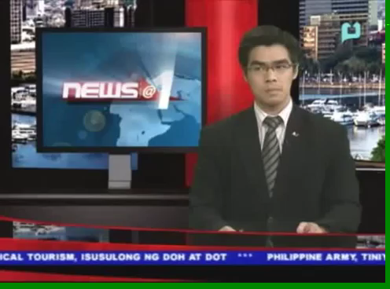

Slide 66
Gov. Gen. Rafael de Izquierdo ordered the execution of Gomburza.
What: REVOLUTION
Who: GOMBURZA
WHY: TOTAL SEPARATION FROM SPAIN

Slide 67
Give me the complete names of the collectively know secular leaders GOMBURZA.

Slide 68
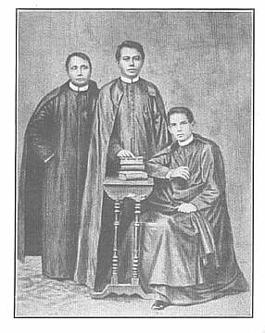
Leaders of Secularization Movement.
MARIANO GOMEZ
JOSE BURGOS
JACINTO ZAMORA

Slide 69
To what novel did Rizal dedicated GOMBURZA?
EL FILIBUSTERISMO

Slide 70
INJUSTICE TO RIZAL’S MOTHER
Doña Teodora and his brother, Jose Alberto were arrested on a malicious charged.

Slide 71
She was imprisoned for 2 and a half years, until Royal Audencia (now SC), acquitted her of the alleged crime with the help of Francisco de Marcaida and Manuel Marzan.

Slide 72
SCHOLASTIC TRIUMPH AT ADMU

Slide 73
What is the former name of Ateneo de Manila?

Slide 74
Rizal was sent to Manila and studied in Ateneo Municipal, formerly known as “Escuela Pia” (Charity School), a school for boys in Manila.
Jesuit System of Education

Slide 75
Why did Ateneo Municipal refused to admit him?

Slide 76
RIZAL ENTERS ATENEO
June 10, 1872, he went to Manila and took entrance test in College of San Juan de Letran.
Fr. Magin Fernando (college registrar) refused to admit him.

Slide 77
RIZAL ENTERS ATENEO
Fr. Magin Fernando (college registrar) refused to admit him.
Late registration
Sickly and undersized

Slide 78
RIZAL ENTERS ATENEO
Through Manuel Xerez Burgos, he was admitted.

Slide 79
Why did Jose did not use the “Mercado” as surname?

Slide 80
Jose was the first to use the surname “Rizal”.
He boarded in a house outside Intramuros, in Caraballo St.

Slide 81
JESUIT SYSTEM OF EDUCATION
Rigid discipline and religious instruction.
Student were divided into 2 groups:
Roman Empire (Internos)
Carthaginian Empire (Externos)

Slide 82
JESUIT SYSTEM OF EDUCATION
Each empire has its ranks:
Rank 1: Emperor
Rank 2: Tribune
Rank 3: Decurion
Rank 4: Centurion
Rank 5: Standard - bearer

Slide 83
JESUIT SYSTEM OF EDUCATION
Red Team
Blue Team
vs.
Romans
Carthaginians

Slide 84
JESUIT SYSTEM OF EDUCATION
1st Defeat: Losing party transfers
to the left.
2nd Defeat: Losing party transfers to the inferior side.
3rd Defeat: Inclined flag on the left
4th Defeat: Reverse flag to the right
5th Defeat: Flag changed to a figure of a donkey.

Slide 85
Who is Rizal’s first professor in Ateneo?

Slide 86
First Year in Ateneo
Rizal’s first professor in
Ateneo is Fr. Jose Bech
He was a Carthaginian, Externo.
At the end of the year, he
became Emperor.

Slide 87
First Year in Ateneo
He took private lessons in
Santa Isabel College.
All of his grades marked
“Sobresaliente”

Slide 88
Summer Vacation
Rizal was lonely because of his mother’s imprisonment.

Slide 89
Second Year in Ateneo
He meet his old classmates in Biñan.

Slide 90
Prophecy of mother’s release
Rizal interpreted mother’s dream.

Slide 91
What is the favorite novel of Rizal?

Slide 92
Teenage Interest in Reading
“Count of Monte Cristo” by Alexander Dumas
“Universal History” by
Cesar Cantus
“Travels in the Philippines” by
Dr. Feodor Jagor

Slide 93
Third Year in Ateneo
Doña Teodora released from prison.

Slide 94
Fourth Year in Ateneo
Fr. Francisco de Paula Sanchez inspired him to write poetry.
Topped all the subjects

Slide 95
Last Year in Ateneo
“Pride of Jesuits”

Slide 96
Graduation with the
Highest Honor
Commencement Day:
March 23, 1877; he was 16 years old; Degree of Bachelor of Arts with the highest honor.

Slide 97
Extra – Curricular Activities
Marian Congregation
Academy of Spanish Lit.
Academy of Natural Lit.

Slide 98
Extra – Curricular Activities
Fr. Sanchez – Literature
Fr. Jose Villaclara – Philosophy and Natural Science
Agustin Saez – Painting
Romualdo de Jesus - Sculpture

Slide 99
Sculptural Works in Ateneo
The Virgin Mary
Sacred Heart of Jesus
(for Fr. Leonart)

Slide 100
Anecdotes of Rizal
Felix Roxas – Rizal was hit in the face by a book
Manuel Xerez Burgos – Rizal’s predilection to help the helpless at the risk of his own life

Slide 101
What was the title of the poem that Rizal wrote for his mother during her birthday?

Slide 102
“Mi Primera Inspiracion”

Slide 103
Rizal’s poem on Education
“Through Education our motherland receives light”
“Intimate Alliance Between Religion and Good Education”

Slide 104
Rizal’s poem on Religion
“Al Niño Jesus”
“A La Virgen Maria”

Slide 105
Who was his first love?

Slide 106
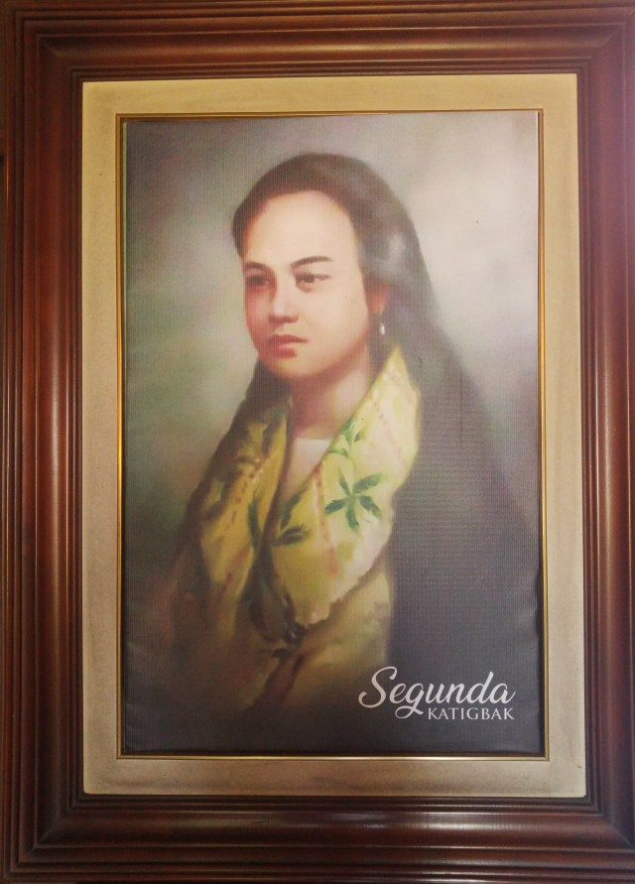
A fourteen-year old Batangueña from Lipa. She is the sister of his Mariano.

